Slide 1
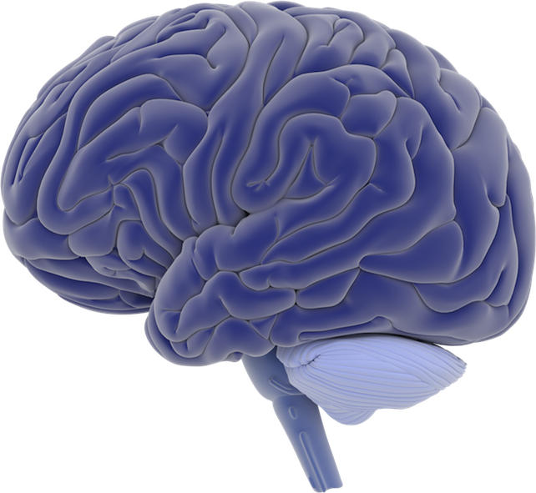
Anatomy of the Human Brain
Parietal Lobe
Frontal Lobe
Occipital Lobe
Temporal Lobe
Cerebellum

